Slide 1
PINN for Burgers’ Equation
Tiansheng Wu
Chiao Hsiao
Junchao Ma
https://drive.google.com/file/d/1OCHtZ2HuntEiQZ3Ph5q_X3E-Jj1Kbb-5/view?usp=sharing
Notes:
Hello Professor, My name is Junchao Ma and we are here to present our PINN network for solving Burgers Equation

Slide 2

Goal
- Solve the Burgers Equation using Physics Informed Neural Network (PINN)
x : spatial coordinate
t : temporal coordinate
u(x, t): speed of fluid at the indicated coordinates
v : viscosity of the fluid
- Deliverable
- 2 inputs (t, x) -> Trained with single v = 0.001 ->Plot of u(t,x)
- 2 inputs (t, x) -> Trained with various v -> Plot of u(t,x)
- 3 inputs (t, x, v) -> Plot of u(t,x) when v = 0.001
Notes:
The goal of this project is to solve the burgers equation shown in the slides using Physics Informed Neural Network. We tested the network three times. The first one is a network with 2 inputs, trained with single v of 0.001 to get a plot of u. The second one is a network with 2 inputs, trained with various v to compare with the first scenarios. In addition, we modified the network to include a third input v and plotted the result when v = 0.001.

Slide 3
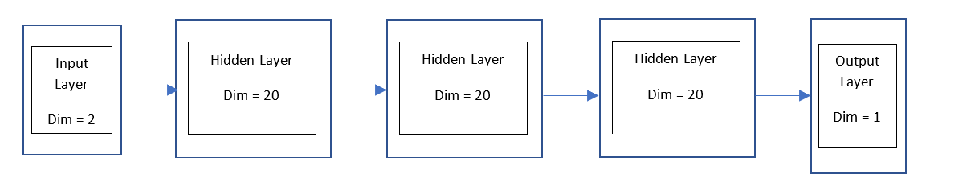
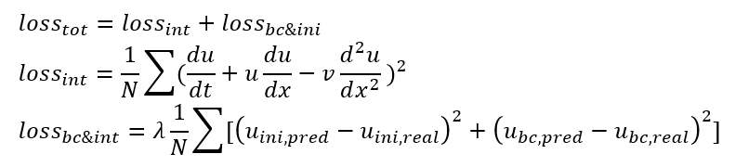
Description of Algorithm
Architecture
Depth: 4
Activation Function: tanh
Regularization parameter: 1e-6
Kernel and bias initializations: RandomNormal
Loss Function
Notes:
As for the algorithm. The original network is composed of 1 input layer, 3 hidden layers and 1 output layer. Each hidden layer has a width of 20 activated with a tanh activation function. In addition, each hidden layer has the randomnormal kernel and bias initializations and a l2 regularization parameter of 1e-6. The modified PINN keeps most settings from the original network, with a smaller width of 16 for faster execution, and a different input dimension of 3.
The loss function for this network will consist of two parts, the interior loss and the boundary plus initial condition loss similar to the loss function that was seen in assignment 3. Now I will hand it over to Chiao Hsiao to talk about the first test we did

Slide 4
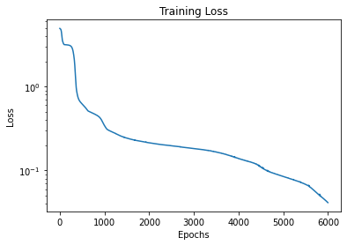
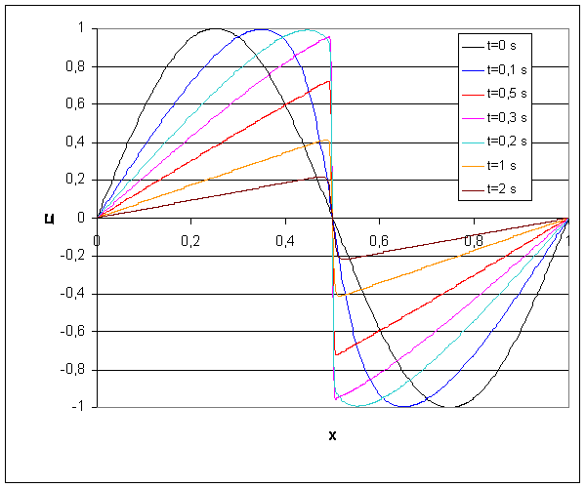
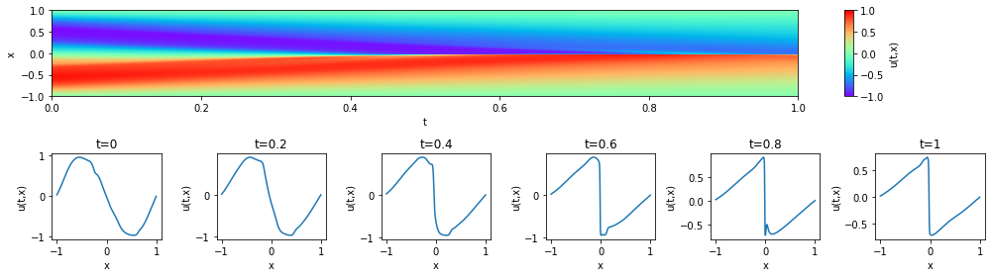
Test 1
Fig 1
Fig 3
Fig 2
Notes:
In this part, we will talk about 3 results of our model, test 1, test2, and test 3.
For the test 1, we use the two-input model with the v to 0.001, and 1000 sample numbers, and 6000 epochs.
For the figure 1, we can see that the training loss keeps decreasing as the epochs increases. Even at 6000 epochs, it still decrease gradually.
And Figure 2 is our PINN result. As you can see, when the t increases, the peak will shift to the center gradually. And for figure 3, it is the numerical solution. Compare it with figure 2, we can see that there are some noise in our PINN result, and it may be solved if we increase the sample size or the number of epochs.

Slide 5
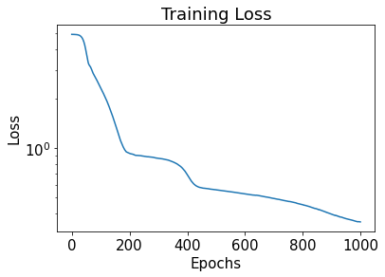
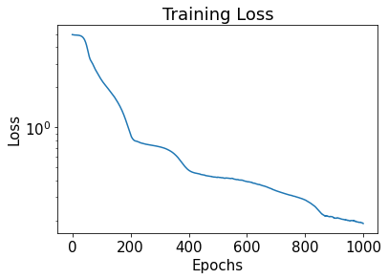
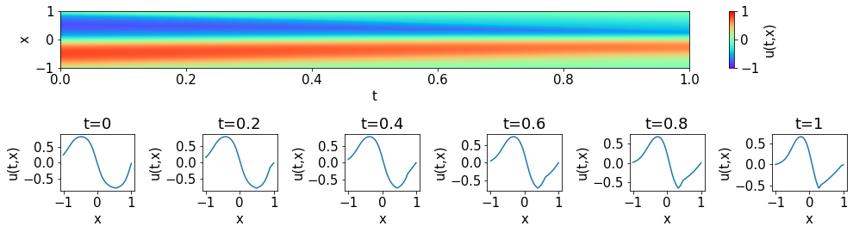
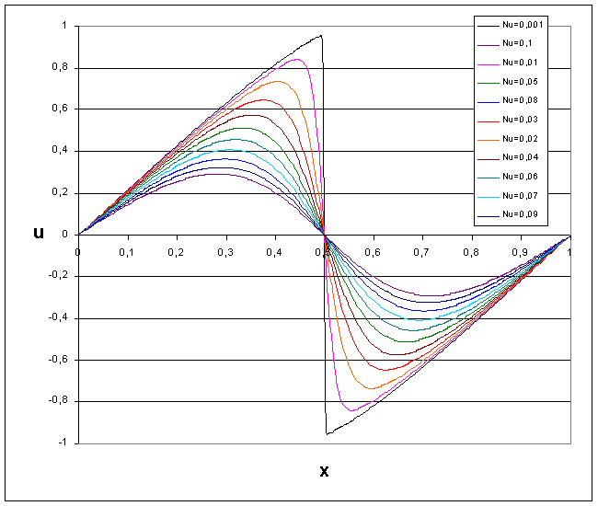
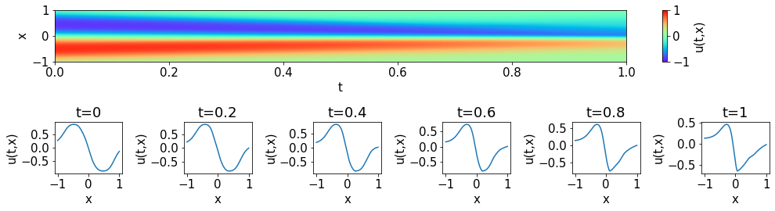
Test 2
Fig 4 (v =0.01)
Fig 5(v =0.05)
Fig 6(v =0.01)
Fig 7(v =0.05)
Fig 8
Notes:
In test 2, we still use the two input model, but we use two different v, 0.01 and 0.05 to compare. The figure 4 and 5 is the loss of these two model, both of them decrease when the epochs increase.
And the figure 6 and 7 are the result of them, compare to plot in the test 1, in the figure 2, the peak value of u are 1 or almost 1. However, for test 2, in the figure 6 and 7, the peak value of u are less than 1
Accordingly, in the figure 8, we compare the result with different v, and when the v increases, the peak value will decrease gradually.
And for the test 3, let change to 天勝 to explain.

Slide 6
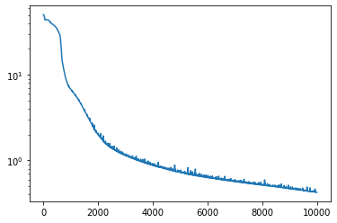
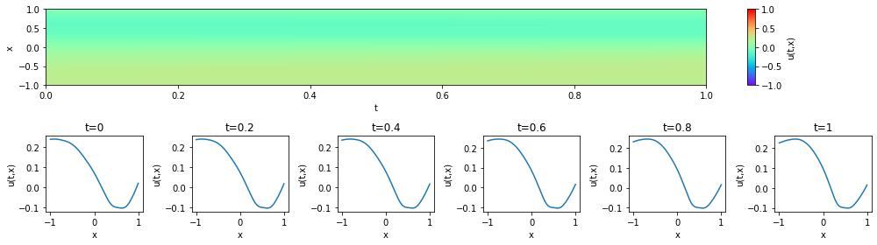
Test 3 (v as input) N = 10,000 , Epoch = 10,000

Slide 7
Conclusion and Summary
- Good performance on tests with two inputs t, x
- Unsatisfactory on tests with three inputs t, x, v
- Long computation time
- Lack of epochs
Future work:
- Decrease computation time
- Increase number of epochs
- Increase number of samples

